Slide 1
PowerShell Toolmaking
Module 15

Slide 2
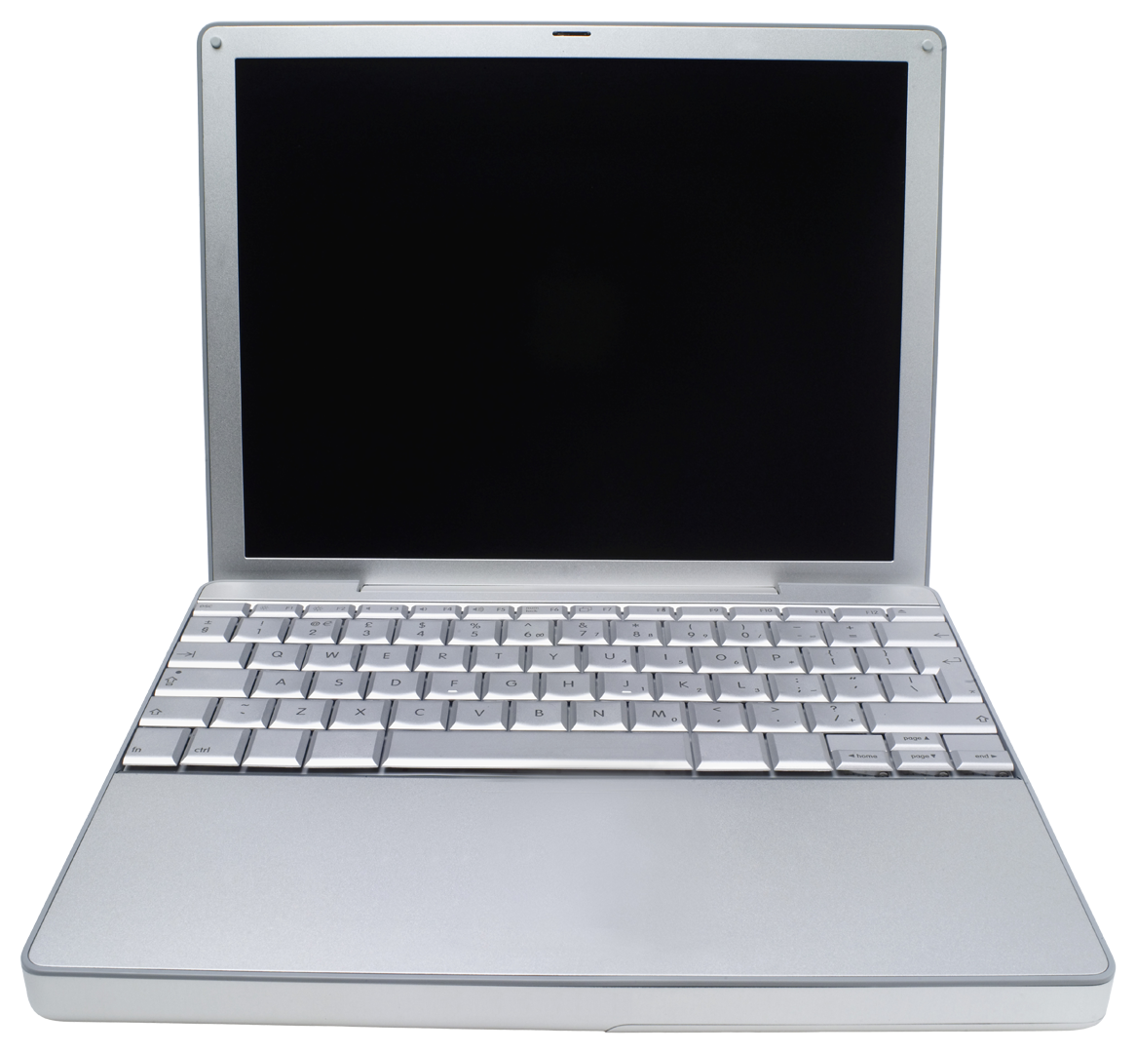
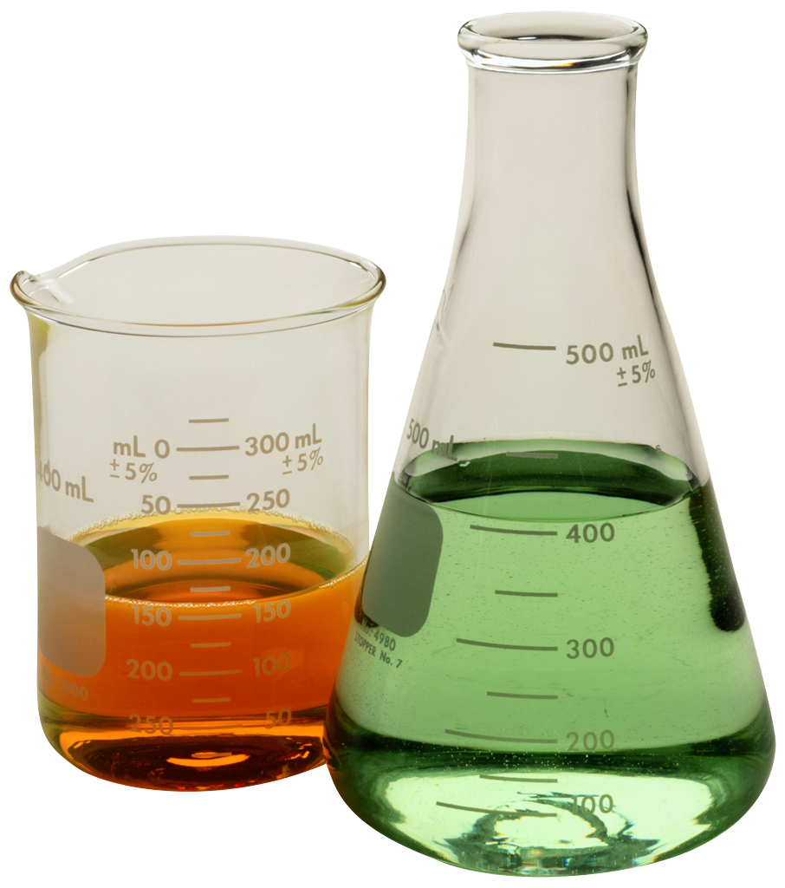
Lab A
120 Minutes
CLIENT
MEMBER
DC
Administrator P@ssw0rd

